Slide 1
M3-MIFARE DESFire Training
MIFARE DESFire EV1 Commands Overview
Abu Ismail, BUID CAS
MIFARE DESFire EV1
Standard Product Training
2013

Slide 2
Content
MIFARE DESFire EV1 commands
Different types of command-response frame
Command-response frame selection
Application level chaining and ISO14443-4 level chaining in MIFARE DESFire EV1
Example transaction time
M306_MIFARE DESFire Training - MIFARE DESFire EV1 Commands_AIv12.01.ppt

Slide 3
MIFARE DESFire EV1 command structure
ISO14443A
Security commands
PICC
level
commands
Application
level commands
File level commands
M306_MIFARE DESFire Training - MIFARE DESFire EV1 Commands_AIv12.01.ppt

Slide 4
ISO/IEC 14443 commands
ISO 14443A-3
- Request Type A (REQA)
- Wake-Up (WUPA)
- Anticollision & Select Cascade Level 1
- Anticollision & Select Cascade Level 2
ISO 14443-4
- Request for Answer To Select (RATS)
- Protocol and Parameter Selection (PPS)
- Frame Waiting Extension (WTX)
MIFARE DESFire EV1 command set
using APDU exchange (T=CL)
M306_MIFARE DESFire Training - MIFARE DESFire EV1 Commands_AIv12.01.ppt

Slide 5
MIFARE DESFire EV1 security related command
Authenticate (KeyNr): Authentication in MIFARE DESFire Native TDES mode. MIFARE DESFire native TDES enciphering and deciphering.
AuthenticateISO (KeyNr): Authentication in standard TDES mode. (Not in EV0)
AuthenticateAES (KeyNr): Authentication in standard AES mode. (Not in EV0)
GetKeyVersion (KeyNr): Returns the key version. Incorrect interpretation can weaken the key.
GetKeySettings( ): Returns settings of the application/key.
ChangeKeySettings (KeySettings): Changes the key/application settings.
ChangeKey (keyNr, cryptogram): Updates the key, Calculation of the cryptogram is different for different conditions.
M306_MIFARE DESFire Training - MIFARE DESFire EV1 Commands_AIv12.01.ppt

Slide 6
MIFARE DESFire EV1 card level command
CreateApplication(…):Provide the crypto required for this application, carefully set the settings.
DeleteApplication(AID): Will not free the memory, but the memory used for administration will be reused. Also supported from the application.
GetApplicationIDs( ): lists the existing application IDs.
GetDFNames( ): lists the existing DFs according to ISO/IEC 7816. (Not in EV0)
SelectApplication(AID): Within an application another application can be selected, does not require to go through root. Any time selecting AID ‘000000’ will select card root.
FormatPICC( ): formats the complete memory, can be disabled.
GetVersion( ): provides HW/SW versions, UID
FreeMem( ): provides, how much memory is left. (Not in EV0)
SetConfiguration( ): Sets advanced configuration e.g. defined ATS, RID, default key,
disabling “Format PICC” options. (Not in EV0)
GetCardUID( ): provide the UID if RID enabled, after any key authentication and encrypted, (Not in EV0)
M306_MIFARE DESFire Training - MIFARE DESFire EV1 Commands_AIv12.01.ppt

Slide 7
MIFARE DESFire EV1 application level command
GetFileIDs
GetISOFileIDs (Not in EV0)
GetFileSettings
ChangeFileSettings(FileNo,CommSet,AccessRights)
CreateStdDataFile(FileNo,CommSet,AccessRights,FileSize)
CreateBackupDataFile(FileNo,CommSet,AccessRights,FileSize)
CreateValueFile(FileNo,CommSet,AccessRights,
LowerLimit,UpperLimit,Value,LimitedCreditEnabled)
CreateLinearRecordFile(FileNo,CommSet,AccessRights,
RecSize,MaxNumOfRecords)
CreateCyclicRecordFile(FileNo,CommSet,AccessRights,
RecSize,MaxNumOfRecords)
DeleteFile(FileNo): will not free the memory, but the administrative memory used will be reused.
M306_MIFARE DESFire Training - MIFARE DESFire EV1 Commands_AIv12.01.ppt

Slide 8
MIFARE DESFire EV1 file access command
ReadData(FileNo,Offset,Length)
WriteData(FileNo,Offset,Length)
GetValue(FileNo)
Credit(FileNo,Data)
LimitedCredit(FileNo,Data)
Debit(FileNo,Data)
WriteRecord(FileNo,Offset,Length,Data)
ReadRecords(FileNo,Offset,Length)
ClearRecordFile(FileNo)
CommitTransaction
AbortTransaction
M306_MIFARE DESFire Training - MIFARE DESFire EV1 Commands_AIv12.01.ppt

Slide 9
MIFARE DESFire EV1 ISO/IEC 7816-4 INS
Select: INS code “A4”
Read Binary : INS code “B0”
Update Binary: INS Code “D6”
Read Records: INS code “B2” (Not in EV0)
Append Records: INS code “E2” (Not in EV0)
Get Challenge: INS code “84” (Not in EV0)
Internal Authentication: INS code “88” (Not in EV0)
External Authentication: INS Code “82” (Not in EV0)
For mutual authentication
M306_MIFARE DESFire Training - MIFARE DESFire EV1 Commands_AIv12.01.ppt

Slide 10


MIFARE DESFire EV1 command response pair
Embedded in T = CL according to ISO/IEC 14443-4
PCB
CID
INF
EDC (CRC16)
Color scheme is followed in full presentation
APDU
Command frame: Command to PICC
Response frame: Response from PICC
Most of the commercial reader takes care of PCB, CID and CRC16.
MIFARE DESFire EV1 Supports 3 types of command-response frame:
MIFARE DESFire EV1 native frame
Native frame wrapped in ISO7816 APDU
ISO7816-4 standard APDU
M306_MIFARE DESFire Training - MIFARE DESFire EV1 Commands_AIv12.01.ppt

Slide 11
MIFARE DESFire EV1 native frame
PCD
PICC
PCB
CID
CMD Parameters Data
EDC (CRC16)
if any
if any
PCB
CID
Status Data
EDC (CRC16)
CMAC if any
if any
Example: Reading 5 bytes from offset 00 at file no 1
0A
01
BD 01 000000 0500000
xxxx
parameters
0A
01
00 1122334455
xxxx
PCB
data
CID
CRC
PCB
CMD: Read data file
CID
CRC
Status: OK
M306_MIFARE DESFire Training - MIFARE DESFire EV1 Commands_AIv12.01.ppt

Slide 12
MIFARE DESFire EV1 native frame wrapped in ISO7816 APDU
PCD
PICC
PCB
CID
CMD Parameters Data
CRC16
if any
if any
Native
Maximum 64 bytes
PCB
CID
Status Data
CRC16
CMAC if any
if any
Maximum 64 bytes
PCB
CID
CLA byte
‘90’
INS
(same cmd
as in Native)
P1
‘00’
P2
‘00’
Lc
Data (all parameters and
data as required in
native except the cmd )
Le
‘00’
CRC16
Wrapping of native in ISO7816
Maximum 64 bytes
C-APDU
PCB
CID
Data if any
CMAC
if required
SW1
‘91’
SW2
Status as
in native
CRC16
R-APDU
Maximum 64 bytes
Crypto calculation is same as in native frame, doesn’t include CLA,P1, P2, Lc, Le.
Note extra 6 byte for each command-response, extra time ☹.
M306_MIFARE DESFire Training - MIFARE DESFire EV1 Commands_AIv12.01.ppt

Slide 13
MIFARE DESFire EV1 APDU Wrapped in ISO7816 Example
Example: Reading 5 bytes from file no 1 at offset 0
PCB
CID
01 000000 0500000
CRC16
Native
BD
CMD
parameters
PCB
CID
00 1122334455
CRC16
status
data
PCB
CID
90
BD
00
00
07
01 000000 0500000
00
CRC16
CLA INS P1 P2 LC
parameters
Wrapped
PCB
CID
1122334455
91
00
CRC16
Data SW1 SW2
Example: Writing 5 bytes to file no 1 at offset 0
PCB
CID
3D
01 000000 050000 1122334455
CRC16
Native
CMD
Parameters and data
PCB
CID
00
CRC16
status
01 000000 0500000 1122334455
PCB
CID
90
3D
00
00
0C
00
CRC16
CLA INS P1 P2 LC
Parameters and data
Wrapped
PCB
CID
91
00
CRC16
SW1 SW2
M306_MIFARE DESFire Training - MIFARE DESFire EV1 Commands_AIv12.01.ppt

Slide 14
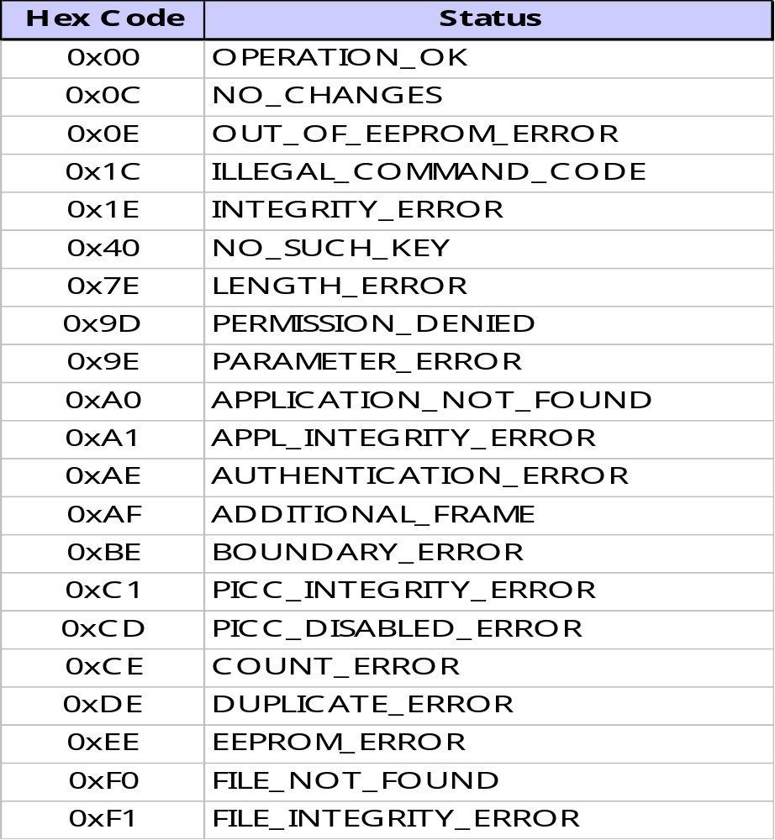
MIFARE DESFire EV1 status and error codes
* Status bytes indicate whether the command is successfully performed
M306_MIFARE DESFire Training - MIFARE DESFire EV1 Commands_AIv12.01.ppt

Slide 15
MIFARE DESFire EV1 Chaining in native frame
If PCD buffer >= 64-byte there is no ISO/IEC 14443-4 chaining.
Example: Reading 100 bytes from a data file
PCD (buffer ≥ 64 bytes)
MIFARE DESFire EV1 (64-byte buffer)
ReadData(FileNo,Offset,Length)
I(0)_{x}
CID
BD
01
000000
640000
EDC
PCB
Cmd
File no
Offset
Length
I(0)_{x}
CID
AF
DATA (up to 59 bytes)
EDC
Status
I(0)_{y}
CID
AF
EDC
Status
I(0)_{y}
CID
00
DATA (rest bytes)
EDC
Status
I(0): Chain bit not set; I(1): Chain bit set; x, y = 0 or 1; EDC = 2-byte CRC16
M306_MIFARE DESFire Training - MIFARE DESFire EV1 Commands_AIv12.01.ppt

Slide 16
MIFARE DESFire EV1 chaining in native frame
If PCD buffer < 64-byte there is ISO/IEC 14443-4 and application level chaining.
Example: Reading 100 bytes from a data file
PCD (buffer 32 bytes)
DESFire (64-byte buffer)
ReadData(FileNo,Offset,Length)
I(0)_{x}
CID
BD
01
000000
640000
EDC
1st ISO/IEC 14443-4 chain block
PCB
Cmd
File no
Offset
Length
I(1)_{x}
CID
AF
DATA (27 bytes)
EDC
Status
R(ACK)_{y}
CID
2nd ISO/IEC 14443-4 chain block
I(1)_{y}
CID
DATA (28 bytes)
EDC
1st chaining of status+59-byte of data
R(ACK)_{x}
CID
3rd ISO/IEC 14443-4 chain block
I(0)_{x}
CID
DATA (4 bytes)
EDC
I(0)_{y}
CID
AF
EDC
1st ISO/IEC 14443-4 chain block
I(1)_{y}
CID
00
DATA (27 bytes)
EDC
Status
2nd chaining of status +41-byte of data
Status
R(ACK)_{x}
CID
2nd ISO/IEC 14443-4 chain block
I(0)_{x}
CID
DATA (14 bytes)
EDC
I(0): Chain bit not set; I(1): Chain bit set; x, y = 0 or 1; EDC = 2-byte CRC16
M306_MIFARE DESFire Training - MIFARE DESFire EV1 Commands_AIv12.01.ppt

Slide 17
MIFARE DESFire EV1 Chaining in wrapped APDU
If PCD buffer >= 64-byte there can be both ISO/IEC 14443-4 and application level chaining.
Example: Reading 100 bytes from a data file
PCD (buffer ≥ 64 bytes)
MIFARE DESFire EV1 (64-byte buffer)
ReadData(FileNo,Offset,Length)
I(0)_{x}
CID
90 BD 00 00 07 01000000640000 00
EDC
PCB
CLA INS P1 P2 Lc data filed Le
I(1)_{x}
CID
DATA (up to 59 bytes)+91
EDC
ISO/IEC 14443-4 chaining
R(ACK)_{y}
CID
I(0)_{y}
CID
AF
EDC
I(0)_{x}
CID
AF
EDC
I(0)_{x}
CID
DATA (rest bytes) 9100
EDC
I(0): Chain bit not set; I(1): Chain bit set; x, y = 0 or 1; EDC = 2-byte CRC16
M306_MIFARE DESFire Training - MIFARE DESFire EV1 Commands_AIv12.01.ppt

Slide 18
ISO/IEC 7816-4 standard APDU
PCB
CID
CLA byte
‘00’
Standard
INS
P1
P2
Lc
Data +(MAC/CMAC
if required)
Le
xx
CRC16
Maximum 64 bytes
C-APDU
PCB
CID
Data if any
CMAC
if required
SW1
SW2
CRC
R-APDU
Maximum 64 bytes
Example: Selecting DESFire ISO 7816 AID “D2760000850100”
0A
01
00
A4
04
00
07
D2760000850100
-
EDC
PCB
CID
CLA
INS
P1
P2
Lc
parameters
Le
CRC16
0A
01
No data
90
00
EDC
PCB
CID
data
SW1
SW2
CRC16
Please note, in ISO/IEC 7816 standard INS, the application level chaining (0xAF) is not supported,
only standard chaining is supported
M306_MIFARE DESFire Training - MIFARE DESFire EV1 Commands_AIv12.01.ppt

Slide 19
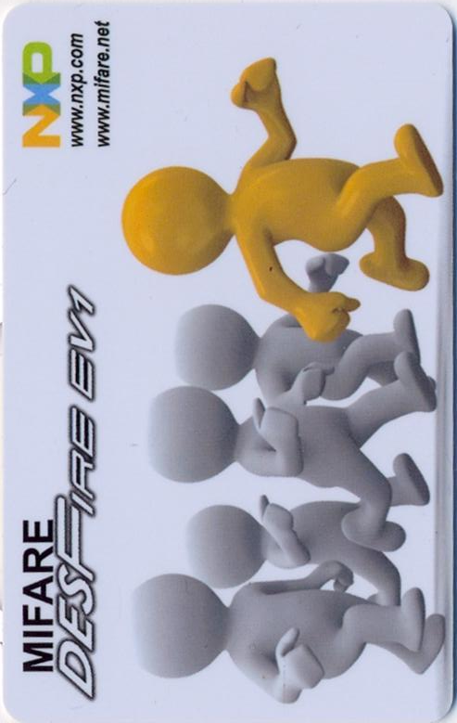
MIFARE DESFire EV1 activation summary
PCD
Power on
> 5 ms
REQA
26
FDT
44
03
ATQA
AN1
93
20
FDT
88
04
uid1
uid2
bcc
RAN1
CT
uid0
SEL1
93
70
88
04
uid1
uid2
bcc
CRC
FDT
24
CRC
SAK1
AN2
95
20
FDT
uid3
uid4
uid5
uid6
bcc
RAN2
SEL2
95
70
uid3
uid4
uid5
uid6
bcc
CRC
FDT
20
CRC
SAK2
RATS
E0
Para.
CRC
FDT
06
75
77
81
02
80
CRC
ATS
Ready for transaction
M306_MIFARE DESFire Training - MIFARE DESFire EV1 Commands_AIv12.01.ppt

Slide 20
MIFARE DESFire EV1 activation summary con.
PCD
<SFGT
PPSR
Dx
11
0x
CRC
<FWT
Dx
CRC
APPSR
Native
CMD
Parameters, data
<FWT
status
Data
Response
OR
ISO 7816
CLA, INS, P1, P2, Lc, Nc, Lc
<FWT
Data
SW1SW2
ISO 7816
MIFARE DESFire EV1 native frame is compact and more time efficient
M306_MIFARE DESFire Training - MIFARE DESFire EV1 Commands_AIv12.01.ppt

Slide 21
MIFARE DESFire EV1 transaction time example
Operation | Time @106kbps | Time @ 424 kbps | Comments
Activation | 05.03 ms |  | ReqA+An1+Sel1+An2+Sel2
RATS | 01.35 ms
PPS | - | 00.97 ms
Select Application | 02.05 ms | 01.23 ms
Authenticate AES | 13.30 ms | 07.75 ms
Read 44 bytes encrypted | 08.05 ms | 03.87 ms | Standard data file
Write 44 bytes encrypted | 11.90 ms | 07.20 ms | Standard data file
Read 44 bytes CMACed | 08.60 ms | 04.20 ms | Standard data file
Write 44 bytes CMACed | 16.00 ms | 10.50 ms | Standard data file
Time shown here includes transmission in both end and MIFARE DESFire EV1 processing time but no PCD processing time.
Total application transaction time depends on the application, nevertheless many standard application showed easy achievable specified transaction time using MIFARE DESFire EV1.
M306_MIFARE DESFire Training - MIFARE DESFire EV1 Commands_AIv12.01.ppt

Slide 22
Thank you very much.
We appreciate your feedback.
Abu Ismail
Senior Engineer, Customer Application Support
Business Unit Identification
NXP Semiconductors Germany GmbH
Stresemannallee 101, 22529 Hamburg, Germany
Tel: +49(0)40 5613 5070, Mob:+49(0)15115210535, Fax:+49(0)40561365070
abu.ismail@nxp.com, http://www.nxp.com, http://www.mifare.net
M306_MIFARE DESFire Training - MIFARE DESFire EV1 Commands_AIv12.01.ppt

